Slide 1

Using “Machine Learning” (a.k.a statistics) to estimate the unknown

Slide 2
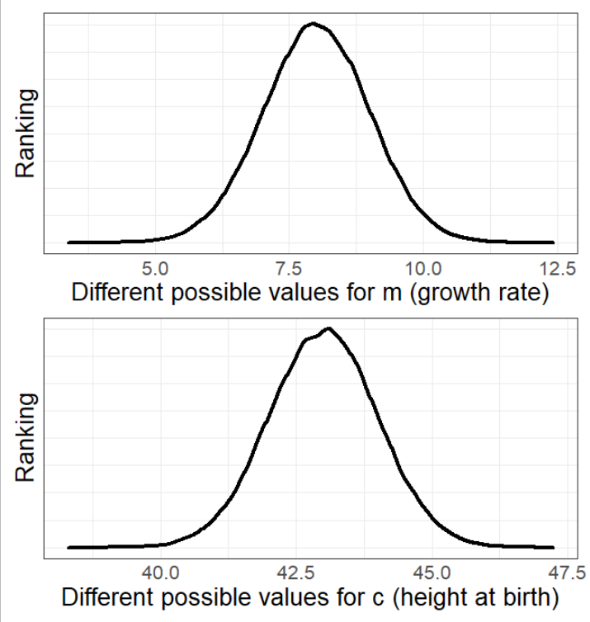
How does the optimiser (and MLE) work?
Previously I said;
‘The “algorithm” tries many different possible values for all parameters.’
But that’s not very satisfying.
What follows is complex.
I do not expect you to understand, I just want to give you an idea of how the engine works.

Slide 3
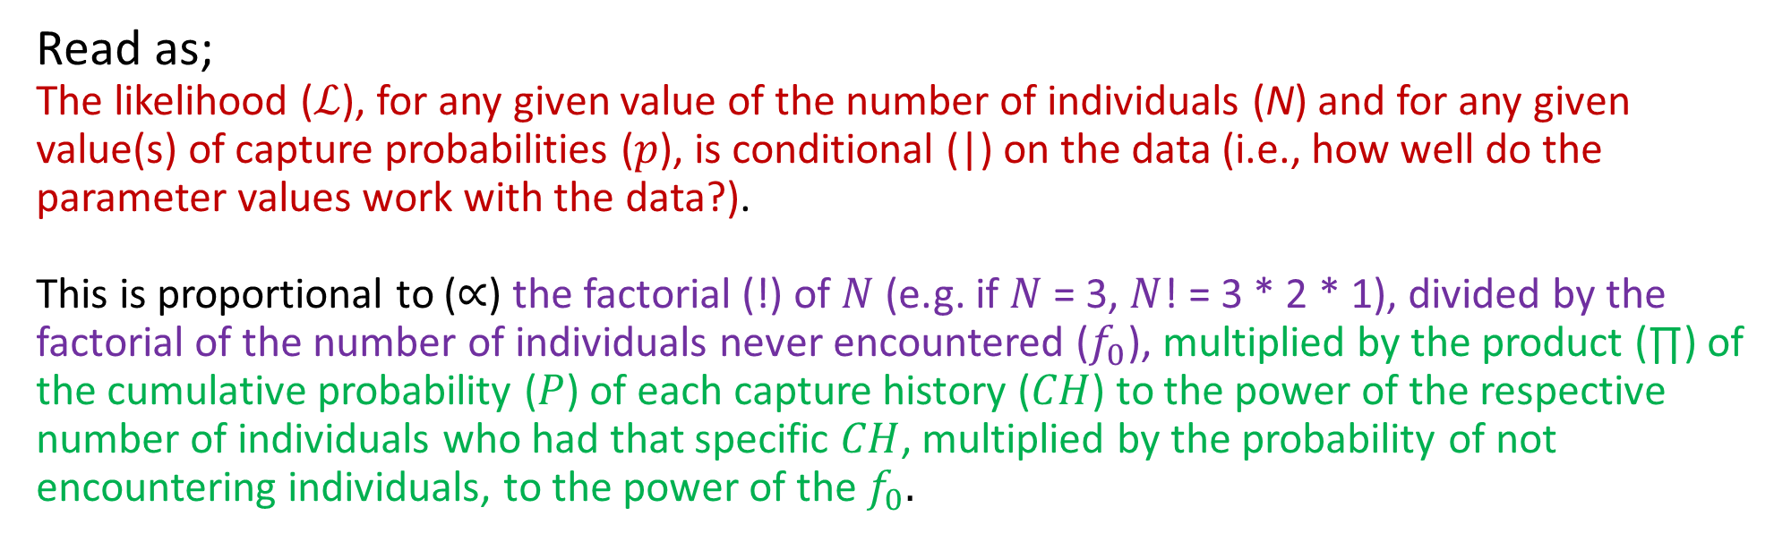
Behind the scenes
The “rating” (a.k.a. the Likelihood) equation
$$ℒ\left(N,p | data\right)∝\frac{N!}{f_{0}!}\prod_{CH}{P{\left[CH\right]}^{n_{CH}}}∗P{\left[not encountered\right]}^{f_{0}}$$
Read as;
The likelihood ($ℒ$), for any given value of the number of individuals (N) and for any given value(s) of capture probabilities ($p$), is conditional (|) on the data (i.e., how well do the parameter values work with the data?).
This is proportional to ($∝$) the factorial (!) of $N$ (e.g. if $N$ = 3, $N$! = 3 * 2 * 1), divided by the factorial of the number of individuals never encountered ($f_{0}$), multiplied by the product (∏) of the cumulative probability ($P$) of each capture history ($CH$) to the power of the respective number of individuals who had that specific $CH$, multiplied by the probability of not encountering individuals, to the power of the $f_{0}.$

Slide 4
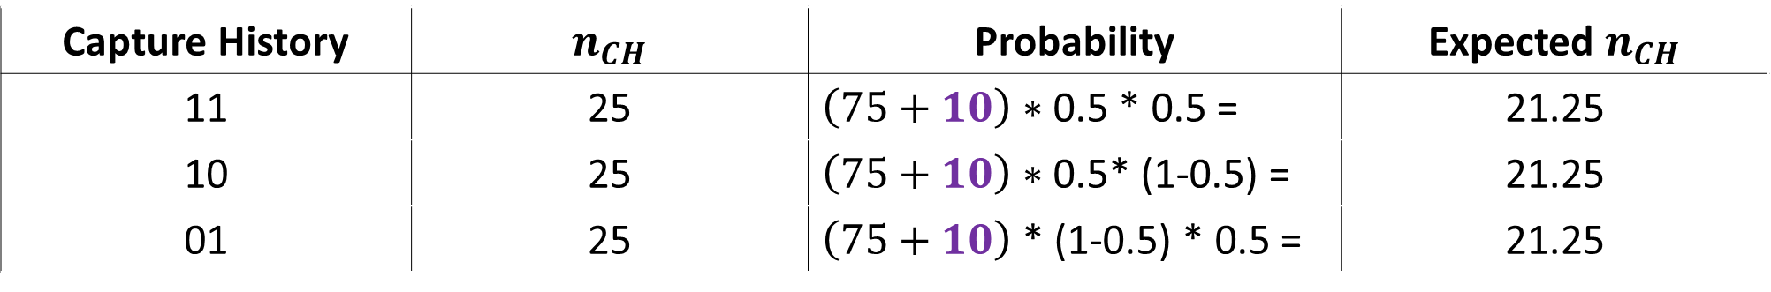
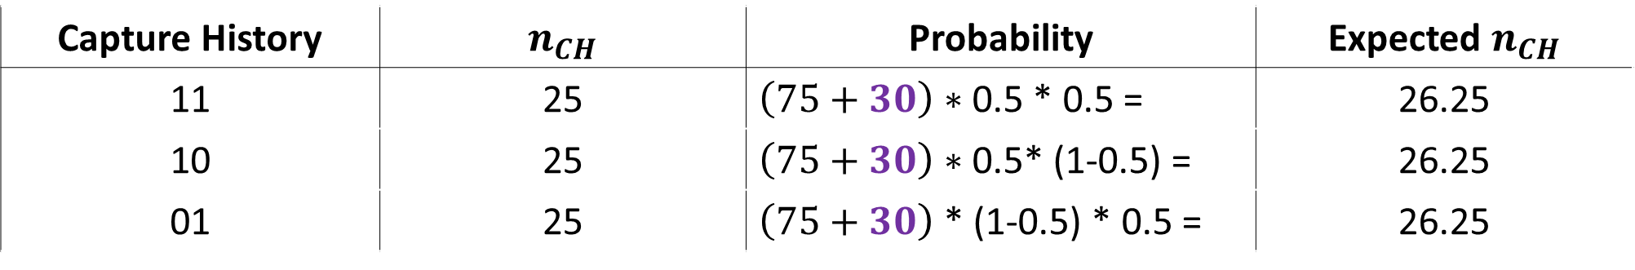
Let’s calculate MLE
Let’s try assuming $f_{0}$ is 10 (i.e. we failed to encounter 10 animals)
Capture History | $n_{CH}$ | Probability | Expected $n_{CH}$
11 | 25 | $\left(75+10\right)∗$ 0.5 * 0.5 = | 21.25
10 | 25 | $\left(75+10\right)∗$ 0.5* (1-0.5) = | 21.25
01 | 25 | $\left(75+10\right)$ * (1-0.5) * 0.5 = | 21.25
How about assuming $f_{0}$ is 30
Capture History | $n_{CH}$ | Probability | Expected $n_{CH}$
11 | 25 | $\left(75+30\right)∗$ 0.5 * 0.5 = | 26.25
10 | 25 | $\left(75+30\right)∗$ 0.5* (1-0.5) = | 26.25
01 | 25 | $\left(75+30\right)$ * (1-0.5) * 0.5 = | 26.25

Slide 5


When $f_{0}$ = 10 and $p$ = 0.5
$$ℒ\left(N,p | data\right)∝\frac{N!}{f_{0}!}\prod_{CH}{P{\left[CH\right]}^{n_{CH}}}∗P{\left[not encountered\right]}^{f_{0}}$$
$$∝\frac{85!}{10!}\prod_{CH}{(0.25{\left[{CH}_{11}\right]}^{25}}∗ 0.25{\left[{CH}_{10}\right]}^{25} ∗ 0.25{\left[{CH}_{01}\right]}^{25}) ∗0.25{\left[{CH}_{00}\right]}^{10}$$
$$∝7.763184e+121 ∗6.681912e−52$$
$$∝5.187291e+70$$
$$∝51,872,910,000,000,002,626,644,064,642,484,628,620,480,602,880,426,460,084,042,624,462,424,266$$

Slide 6
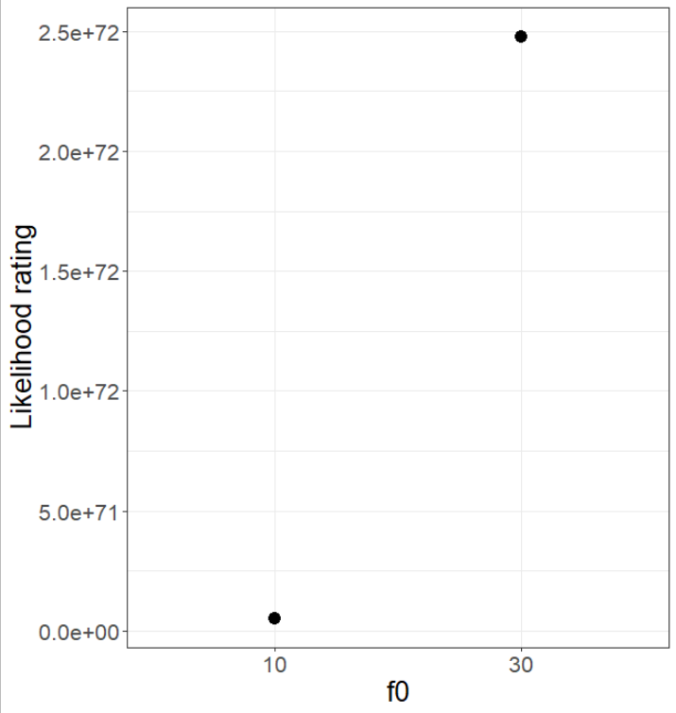


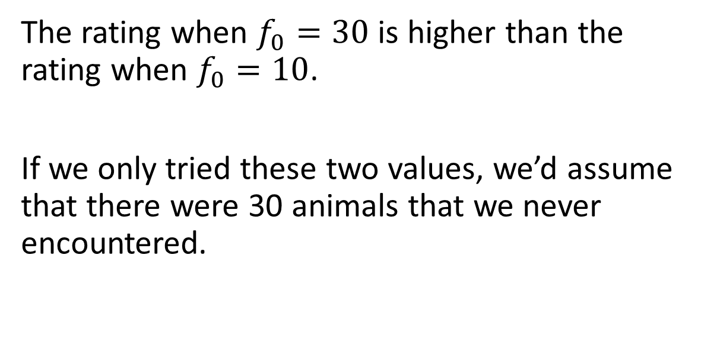
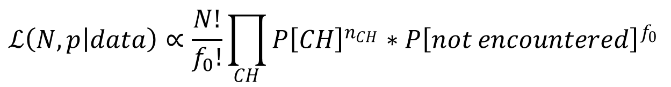
When $f_{0}$ = 30 and $p$ = 0.5
$$ℒ\left(N,p | data\right)∝\frac{N!}{f_{0}!}\prod_{CH}{P{\left[CH\right]}^{n_{CH}}}∗P{\left[not encountered\right]}^{f_{0}}$$
$$∝2.47757e+72$$
The rating when $f_{0}=30$ is higher than the rating when $f_{0}=10$.
If we only tried these two values, we’d assume that there were 30 animals that we never encountered.

Slide 7
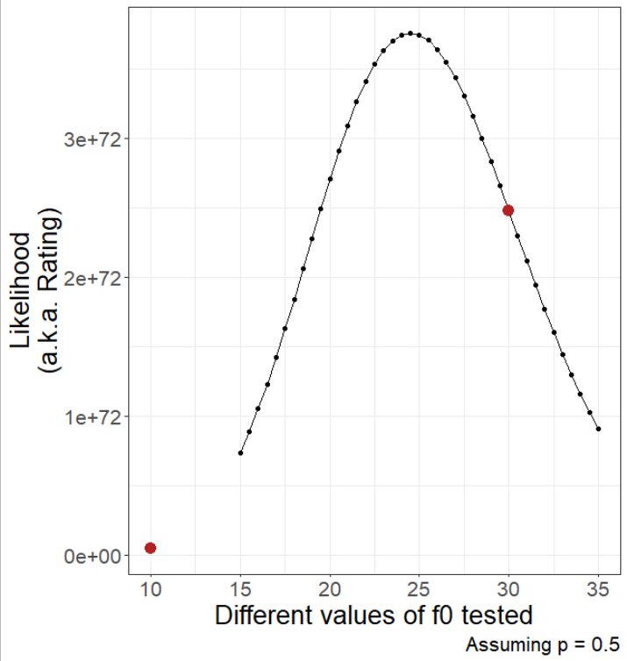

Let the optimiser work
We “maximise” the likelihood when we find the best possible value of $f_{0}$.
In reality, the optimiser is trying combinations of both $f_{0}$ and $p$, to find the best values for both.
There is another use of the likelihood…

Slide 8

Which model best fits our data?
When running analysis, you will invariably have multiple models (each of which reflect a different process), all trying to explain the same pattern, e.g.,
Out of all the models (i.e., processes) that we’ve run, how do we choose the most likely model?
AIC
  “An Information Criteria” or “Information Criterion A”
  “Improperly” called Akaike’s Information Criteria
    He never named it after himself
赤池 弘次, Akaike Hirotsugu

Slide 9
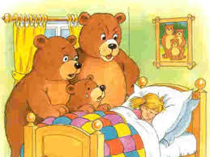
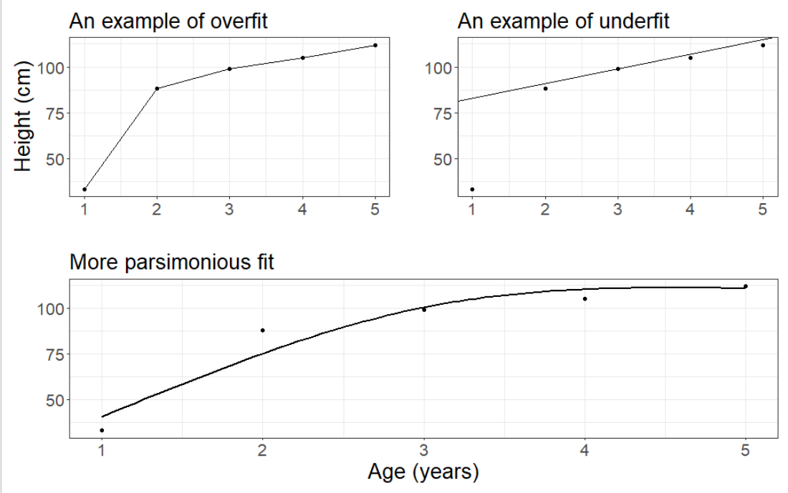
Overfitting and underfitting
Overfit:
Explains data almost “perfectly”
  I.e. model fit (line) goes through each observation
But “costs” lots of parameters
  E.g. here we’ve used 5 parameters with only 5 observations
Underfit:
Explains poorly
  I.e. prediction (line) doesn’t really match the observations
But is very “cheap”
  E.g. here we’ve used 2 parameters with only 5 observations

Slide 10
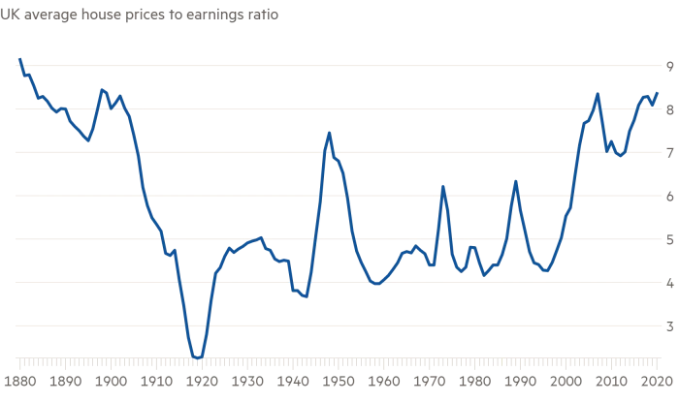
Using AIC to find most the “parsimonious” model
To do so, we use the best Likelihood (MLE) value (“rating”) for each of the different models that we’ve run.
Though we need to tweak the Likelihood
  (and we’ll use this to choose which house we’ll buy)

Slide 11
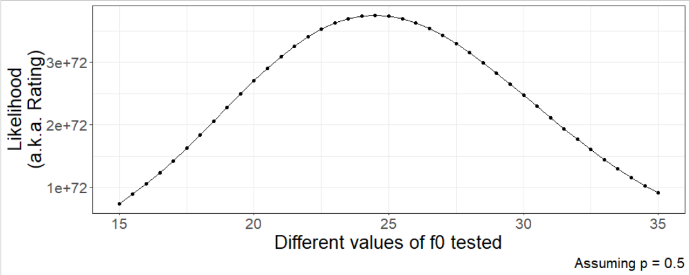
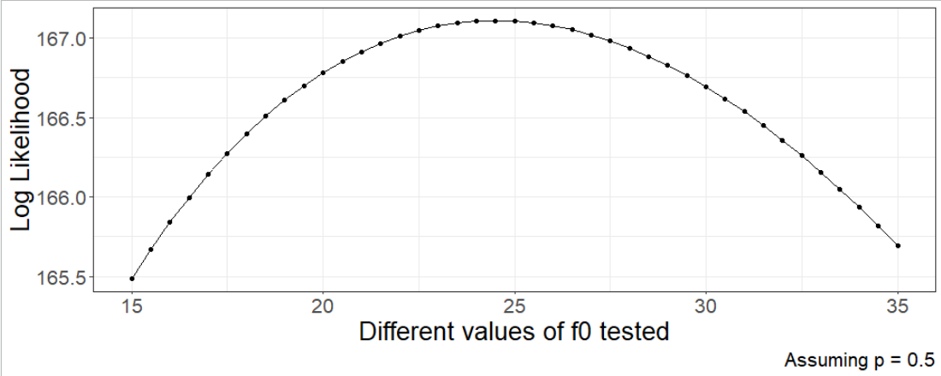
For a single model:
Likelihood to Log-Likelihood
First, log transform the likelihood:

Slide 12
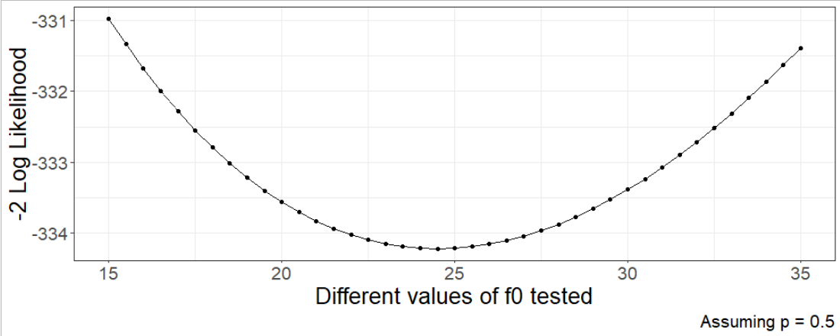
For a single model:
Log-Likelihood to -2*Log Likelihood
Then, multiply the log transform by -2:

Slide 13
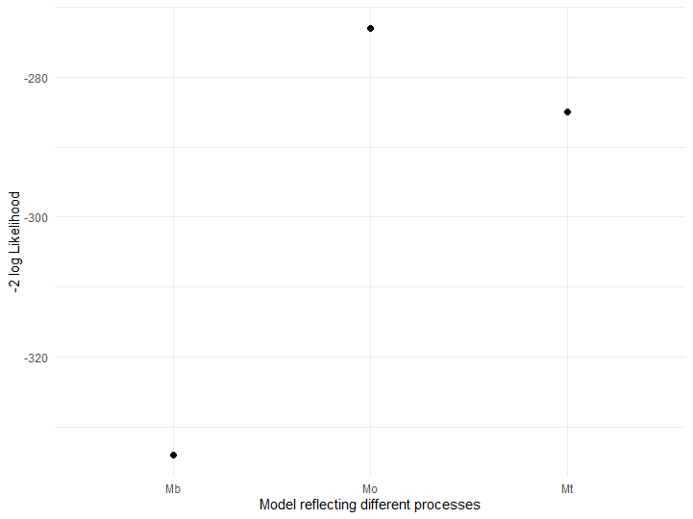
Each model will have a single -2Log Likelihood

Slide 14

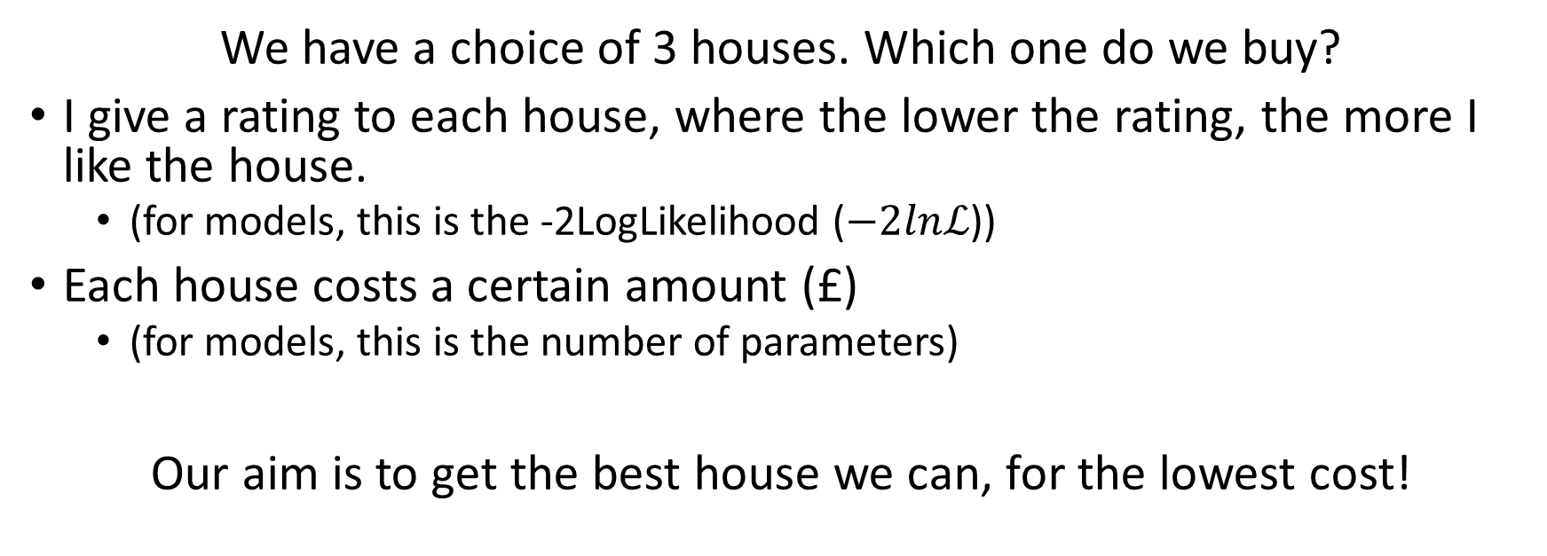
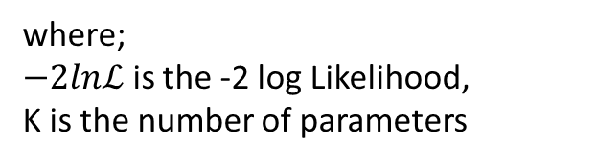
Savvy house buyers
We have a choice of 3 houses. Which one do we buy?
I give a rating to each house, where the lower the rating, the more I like the house.
  (for models, this is the -2LogLikelihood ($−2lnℒ$))
Each house costs a certain amount (£)
  (for models, this is the number of parameters)
Our aim is to get the best house we can, for the lowest cost!
$$AIC=−2lnℒ+2K$$
where;
$−2lnℒ$ is the -2 log Likelihood,
K is the number of parameters

Slide 15
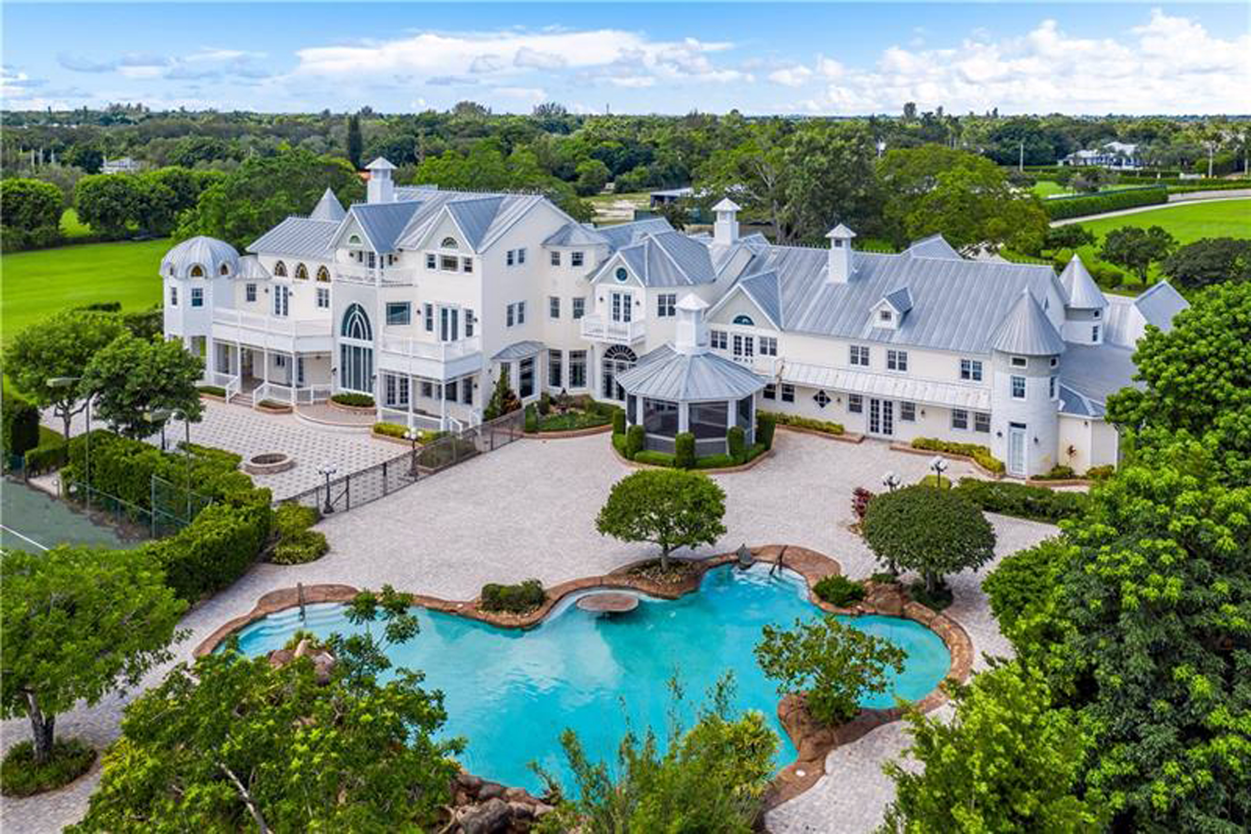
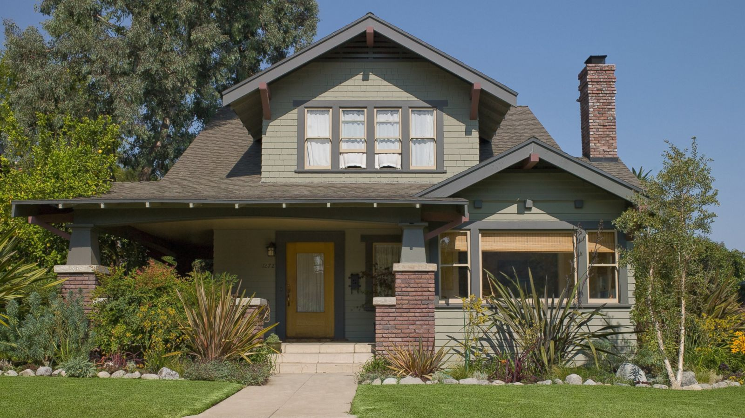
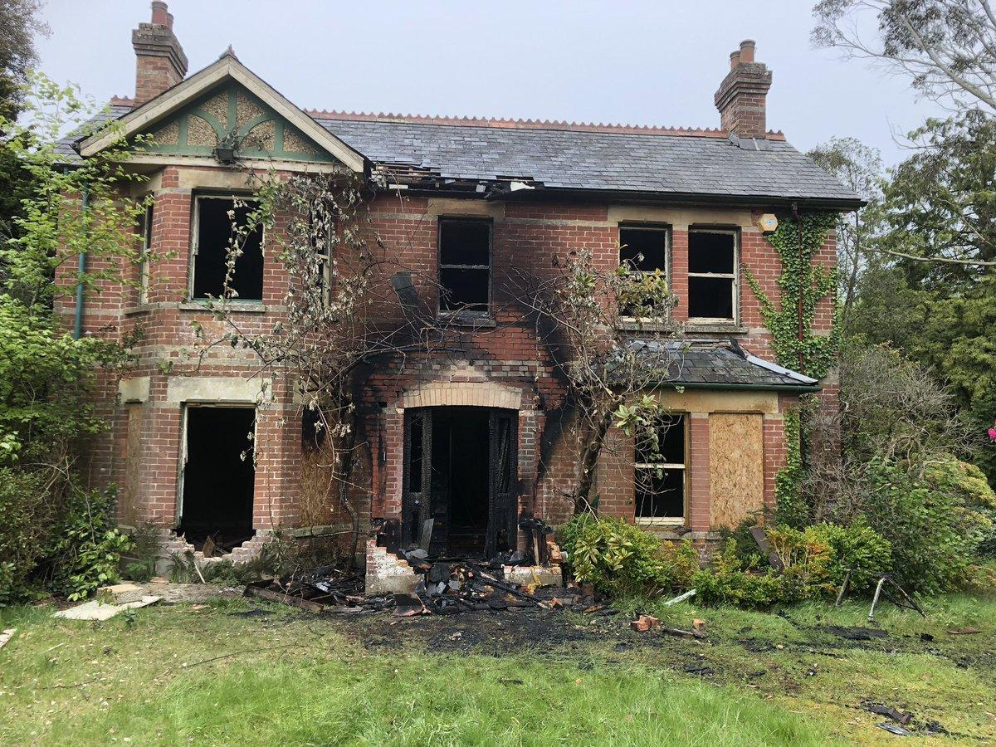
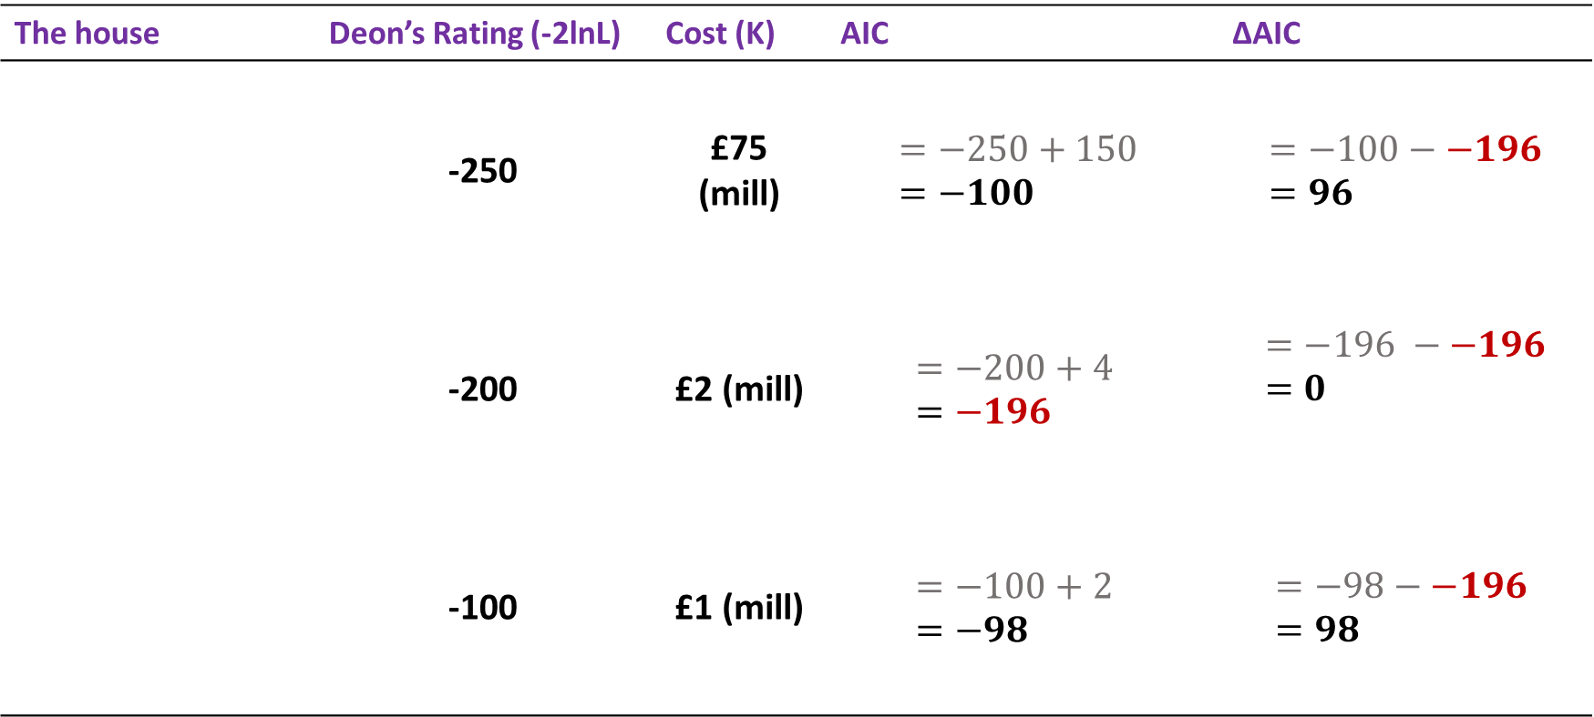

Let’s buy a house
The house | Deon’s Rating (-2lnL) | Cost (K) | AIC | ∆AIC
 | -250 | £75 (mill) | $$=−250+150 =−100$$ | $$=−100−−196=96$$
 | -200 | £2 (mill) | $$=−200+4 \\ =−196$$ | $$=−196 −−196=0$$
 | -100 | £1 (mill) | $$=−100+2 \\ =−98$$ | $$=−98−−196 =98$$
$$AIC=−2lnℒ+2K$$

Slide 16
Model selection with AIC
We select the model with the lowest AIC
  This will be the model where ∆AIC = 0
Any models with ∆AIC > 2, we reject them
If there are models with ∆AIC < 2, both models are valid.
  Of those two models, you choose which one to use
Always run the simplest possible model!
  What if I’d only considered mansions? I’d have to buy a mansion.
No more p-values!

Slide 17
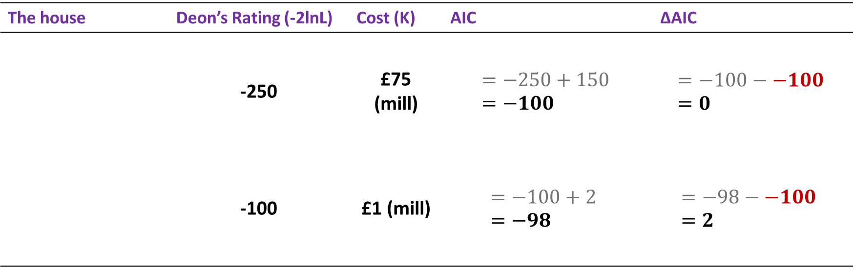

Which house do we choose now?
The house | Deon’s Rating (-2lnL) | Cost (K) | AIC | ∆AIC
 | -250 | £75 (mill) | $$=−250+150 =−100$$ | $$=−100−−100 \\ =0$$
 | -100 | £1 (mill) | $$=−100+2 \\ =−98$$ | $$=−98−−100 \\ =2$$
$$AIC=−2lnℒ+2K$$

Slide 18
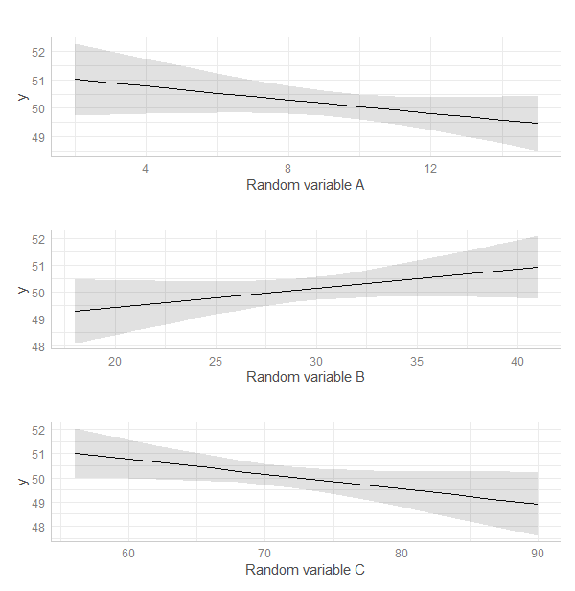
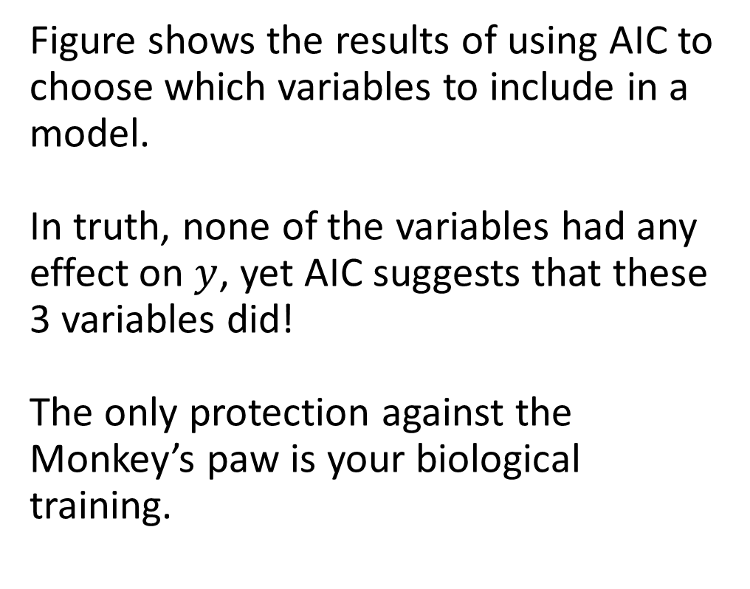
No amount of clever statistics can save you from the Monkey’s paw!
Figure shows the results of using AIC to choose which variables to include in a model.
In truth, none of the variables had any effect on $y$, yet AIC suggests that these 3 variables did!
The only protection against the Monkey’s paw is your biological training.

Slide 19
tl;dr
An optimiser tries different parameter values and finds those parameter values which Maximise the likelihood, giving us the Maximum Likelihood Estimate.
  The Likelihood is just calculated from an equation
  A model will almost always provide parameter estimates. Just because a model can give you values, does not make them reliable.
We can use the MLE of each model to find the most parsimonious model that was tested.
  If two of your lowest models have a ∆AIC ≤ 2 (e.g., 0 and 1.2), you cannot use AIC to distinguish between them.
AIC is a method to distinguish between models, but it doesn’t mean you can turn your brain off! Trust your biological training!

